Slide 1

AI-Powered Customer Support Workflow
Annette Partida
AI Automation

Slide 2
Introduction
Overview of the Customer Support Process
Customer support is the front line of communication between a company and its customers. It typically begins when a customer reaches out with a question, concern, or issue through channels like email, phone, web forms, or social media.
From there, a customer service representative (CSR) logs the inquiry into a system, the request is reviewed and assigned, and the CSR works to investigate and resolve the issue. If the problem is complex or unresolved, it’s escalated to higher-level support. Afterward, customers are invited to provide feedback on their experience.
Project Goal
The goal of this project is to enhance the customer support workflow by integrating AI tools. By streamlining repetitive tasks, speeding up response times, and providing smarter support, we aim to improve both operational efficiency and customer satisfaction.

Slide 3
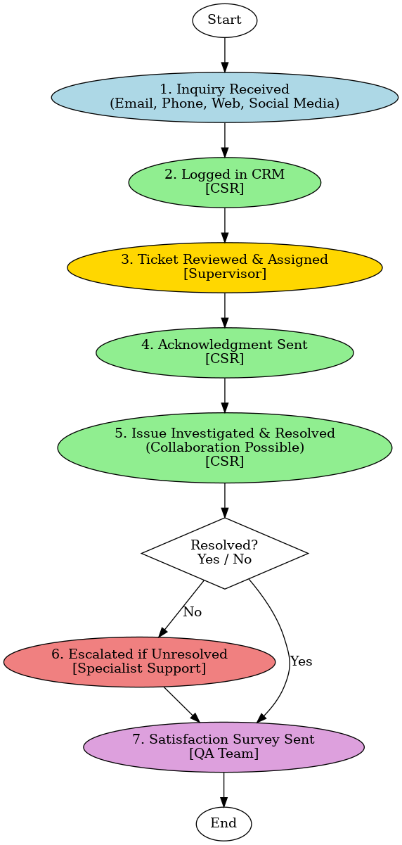
Current Workflow Overview
This is the current workflow overview in chart form:
Customers contact support via email, phone, web, or social media
Rep manually logs the issue
Supervisor assigns it
Rep notifies client/customer that issue is being resolved
Rep works to resolve it
Issue may move on to special support, if not resolved
After resolution, a survey is sent.
A potential for human error exists in manual logging, ticket assignment, and communication, which can lead to delays or inconsistent service.

Slide 4
Entire Complaint Data Summarized
(based on a sample of 50 complaints) :
Workflow Step | Key Problem Identified | Related Complaint Theme | % of Complaints
Step 2 – Ticket Logging | Incomplete or inconsistent entries in CRM | Repetition & Misrouting | 18%
Step 3 – Ticket Assignment | Delayed or incorrect routing by supervisors | Transfers to wrong departments | 18%
Step 4 – Acknowledgment | Late or missing confirmation emails | Long Wait Times, No Response | 22%
Step 5 – CSR Resolution | Scripted replies, lack of product knowledge | Unhelpful agents, Generic interactions | 28%
Step 6 – Escalation | Escalation delays, unresolved complex issues | No resolution after multiple contacts | 20%
Step 7 – Follow-Up | Missing feedback surveys or customer updates | Poor communication, Lack of closure | 7%

Slide 5
Key Problems Identified
For this project 3 key problems have been identified:
Workflow Step | Problem | Impact | Related Complaint Theme | % of Complaints
Step 2 – Manual Data Entry | CSRs manually log inquiries into the CRM | Slows down response time and increases human error | Repetition & Misrouting | 18%
Step 3 – Ticket Assignment Delays | Supervisors assign tickets manually | Causes delays, uneven workload, and routing errors | Transfers & Delayed Responses | 18%
Step 4, 5 – Robotic Customer Interactions | CSRs rely on no or impersonal replies | Makes customers feel ignored, frustrated, and undervalued | Unprofessional or Scripted Interactions | 50%
Solution:
AI can streamline support by automating ticket creation, routing inquiries to the right agent, and providing real-time assistance, reducing errors, speeding up responses, and improving the overall emotional component of customer experience.

Slide 6
Proposed AI integration
Suggested AI Tools
Auto-Ticketing System: Step 2
Integrates with email, chat, and web forms to automatically create tickets in the CRM
Example: Zendesk AI
AI-Powered Ticket Routing: Step 3
Uses NLP and workload analysis to assign tickets to the right CSR based on issue type and skill match
Example: Freshdesk Freddy AI
Real-Time Sentiment Analysis: Step 4, 5
Embedded in CSR dashboard to detect frustration and guide tone adjustments during chats, calls, or confirmation emails
Example: IBM Watson
Expected Benefits & Improvements
Faster Response Times: automatically generates support tickets from multichannel inputs and categorizes them.
Fewer Transfers & Repetitions: everages AI to prioritize and route tickets intelligently based on customer intent, agent load, and SLA rules.
Better Customer Experience: Tone Analyzer integrates with chat platforms to monitor customer sentiment and recommend empathetic responses.
Lower Operational Costs: Reduced human workload and manual tasks.
Potential Risks or Limitations
Integration Complexity: May require IT support and system adjustments.
Model Training Time: AI tools need initial tuning and historical data to be effective.
Privacy Concerns: Sentiment tracking and data analysis must comply with GDPR and data security policies.

Slide 7
Other AI Integration Opportunities:
(not listed in flowchart)
Chatbot – Handles basic FAQs and collects details
Ticket Triage – Tags and routes to best agent
Auto-Acknowledgment – Confirms receipt instantly
Agent Copilot – Suggests responses in real time
Workflow Bot – Coordinates inter-team actions
Escalation Logic – Based on sentiment or SLA
Follow-Up Bot – Sends updates to customers
Sentiment Analysis – Flags dissatisfaction early

Slide 8
AI needs people to monitor output and adjust parameters as needed so the best approach is to adopt a hybrid support model:
Automate repetitive tasks using AI tools
Let humans handle complex empathy-driven interactions
Use AI to enhance speed, consistency, and efficiency
Ensure oversight and continuous learning to maintain quality

Slide 9
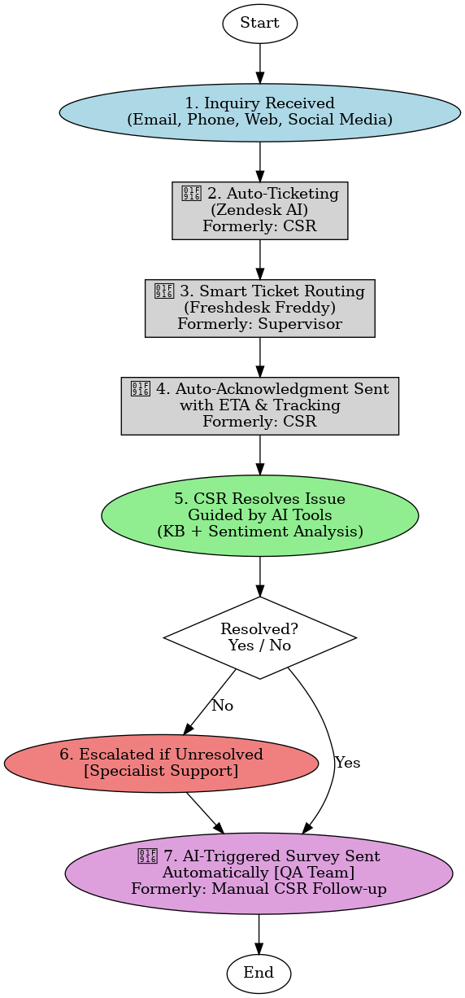
Updated Workflow with AI
By automating routine tasks and intelligently routing issues, AI reduces operational overhead while drastically speeding up resolution times, delivering faster service at a lower cost.
Steps 2, 3, 4, 5, and 7 are now AI-powered using tools like Zendesk AI and Freshdesk Freddy, with human oversight to ensure performance.
AI tools are integrated for auto-ticketing, routing, sentiment analysis, and survey automation.
AI reduces manual workload and speeds up service, but still requires human monitoring.

Slide 10
Conclusion
Integrating AI into the customer support workflow isn't about replacing people. It’s about enhancing how people work. By automating repetitive tasks like ticket logging, routing, and status updates, AI frees up human agents to focus on what they do best: solving complex problems with empathy and creativity.
This updated workflow demonstrates how a hybrid approach improves speed, consistency, and customer satisfaction. Moving forward, organizations can continue to evolve by training AI on real feedback, expanding chatbot capabilities, and aligning automation with human-centered design.

